Slide 1
Lect. 3
How Many Customers Are Still Active?
SQL1.
SELECT COUNT(*) as numstarts,
SUM(CASE WHEN stop_type IS NOT NULL THEN 1 ELSE 0 END) as numstops,
AVG(CASE WHEN stop_type IS NOT NULL THEN 1.0 ELSE 0 END ) as stoprate
FROM subs
WHERE start_date = '2005-12-28'
This query returns the following results:
Exactly 2,409 customers started one year before the cutoff date.
Of these, 484 were stopped on the cutoff date.
The stop rate is 20.1%.
How much confidence do we have in these numbers as representative of all customers one
year after they start? The idea in answering this question is that there is a
process that causes customers to stop. This process is random and behaves like
a lottery.

Slide 2
Random samples and their statistics (not in the book)
Try to run it several times.
SQL2.
SELECT COUNT(*) as numstarts,
SUM(CASE WHEN stop_type IS NOT NULL THEN 1 ELSE 0 END) as numstops,
AVG(CASE WHEN stop_type IS NOT NULL THEN 1.0 ELSE 0 END) as stoprate
FROM
( SELECT TOP 1000 * FROM subs WHERE start_date = '2005-12-28' ORDER BY RAND(CHECKSUM(NEWID())) ) a
Pavyzdys rodantis kaip SQL serveryje paimti atsitiktinius įrašus ir iš jų paskaičiuoti statistikas tokias kaip vidurkis.
Paleidus kelis kartus šį SQL matome kad vidurkis kiekvienu atveju vis kitoks.
Tai rodo svarbų faktą kad duomenų analizės paskaičiavimai dažnai apytikslūs ir mes turime mokėti įvertinti kiek mes tokiais skaičiavimais galime pasitikėti.
Kad geriau suprasti SQL sakinį šioje skaidrėje žemiau pateikiamas naudojamų funkcijų aprašas.
NEWID() Creates a unique value of type unique identifier
CHECKSUM() Returns the checksum value computed over a row of a table, or over a list of expressions.
RAND() Returns a pseudo-random float value from 0 through 1, exclusive.

Slide 3
Random samples and their statistics (not in the book)
SQL3.
IF OBJECT_ID('tempdb..##RelStats') IS NOT NULL --- SELECT * FROM ##RelStats
DROP TABLE ##RelStats
SELECT COUNT(*) as numstarts,SUM(CASE WHEN stop_type IS NOT NULL THEN 1 ELSE 0 END) as numstops, AVG(CASE WHEN stop_type IS NOT NULL THEN 1.0 ELSE 0 END
) as stoprate INTO ##RelStats FROM ( SELECT TOP 100 * FROM subs WHERE start_date = '2005-12-28' ORDER BY RAND(CHECKSUM(NEWID())) ) a
DECLARE @iRecCount int ; SET @iRecCount = 0
WHILE @iRecCount<1200
BEGIN
SET @iRecCount = @iRecCount + 1
INSERT INTO ##RelStats
SELECT COUNT(*) as numstarts,SUM(CASE WHEN stop_type IS NOT NULL THEN 1 ELSE 0 END) as numstops, AVG(CASE WHEN stop_type IS NOT NULL THEN 1.0 ELSE 0 END
) as stoprate FROM ( SELECT TOP 100 * FROM subs WHERE start_date = '2005-12-28' ORDER BY RAND(CHECKSUM(NEWID())) ) a
END
Pavyzdys rodantis kaip SQL serveryje paleisti SQL2 sakinį iš antros skaidrės kelis kartus ir gautus rezultatus patalpinti į tarpinę lentelę ##RelStats.

Slide 4
Random samples and their statistics (not in the book)
SQL4.
SELECT numstops,COUNT(1) as scounts FROM ##RelStats GROUP BY numstops ORDER BY numstops
Pavyzdys rodantis kaip sugrupuoti duomenis tarpinėje lentelėje gautoje iš SQL3 ir atvaizduoti juos kaip histogramą.
Kaip matome klientų skaičius kurie nutraukė sutartį yra atsitiktinis dydis kurio pasiskirstymą apytiksliai nusako gauta histograma.

Slide 5
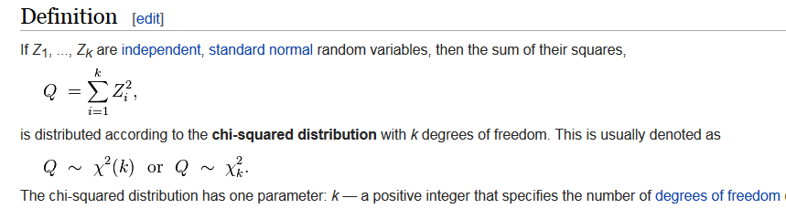
Chi-Square
A chi-square test, also referred to as test (infrequently as the chi-squared test), is any statistical hypothesis test in which the sampling distribution of the test statistic is a chi-square distribution when the null hypothesis is true. The chi-squared test is used to determine whether there is a significant difference between the expected frequencies and the observed frequencies in one or more categories.

Slide 6
Chi-squared Test of Independence in R
http://www.r-tutor.com/elementary-statistics/goodness-fit/chi-squared-test-independence
Example
In the built-in data set survey, the Smoke column records the students smoking habit, while the Exer column records their exercise level. The allowed values in Smoke are "Heavy", "Regul" (regularly), "Occas" (occasionally) and "Never". As for Exer, they are "Freq" (frequently), "Some" and "None".
Problem
Test the hypothesis whether the students smoking habit is independent of their exercise level at .05 significance level.
Solution
We apply the chisq.test function to the contingency table tbl, and found the p-value to be 0.4828.

Slide 7
Where Is It All Happening? Location
CHAPTER 4

Slide 8
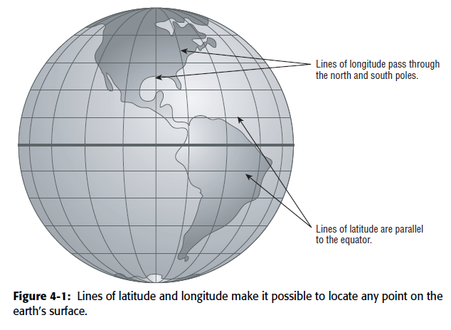
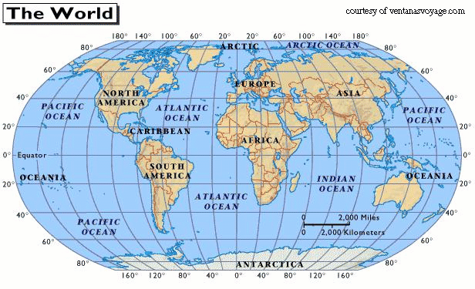
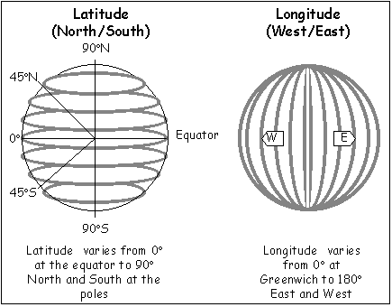
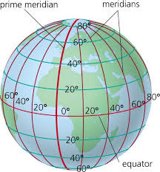

Slide 9
! Kursinis. Galime pasirinkti vieną iš žemiau pateiktų sistemų ir pristatyti jas akcentuojant galimybę padėti savo duomenis ir gauti duomenis analizei.
http://www.maps.lt
https://www.google.lt/maps
http://www.bing.com/maps

Slide 10
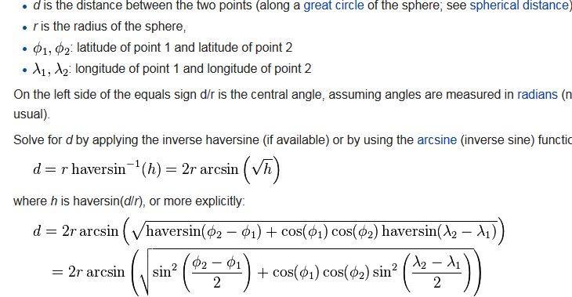
The haversine formula is an equation important in navigation, giving great-circle distances between two points on a sphere from their longitudes and latitudes.

Slide 11
SQL query p140 ; uses this formula to find the ten zip codes closest to the center of the continental
United States using the more accurate method (The geographic center of the continental United States is in the middle of Kansas and has a longitude of –98.6° and a latitude of 39.8°.)
SELECT TOP 10 zipcode, state, population, latitude, longitude, disteuc, distcirc
FROM (
SELECT zc.*, ACOS(COS(centerlatrad)*COS(latrad)* COS(centerlongrad - longrad) +SIN(centerlatrad)*SIN(latrad))*radius as distcirc,(CASE WHEN latitude > 39.8 THEN SQRT(SQUARE(difflat*68.9) + SQUARE(difflong*SIN(latrad)*68.9)) ELSE SQRT(SQUARE(difflat*68.9) + SQUARE(difflong*SIN(centerlatrad)*68.9)) END) as disteuc FROM (
SELECT zc.*, latitude - 39.8 as difflat,longitude - (-98.6) as difflong,latitude*PI()/180 as latrad, 39.8*PI()/180 as centerlatrad,longitude*PI()/180 as longrad,(-98.6)*PI()/180 as centerlongrad,3949.9 as radius FROM zipcensus zc) zc
) zc
ORDER BY disteuc

Slide 12
http://en.wikipedia.org/wiki/Web_Map_Service
A Web Map Service (WMS) is a standard protocol for serving georeferenced map images over the Internet that are generated by a map server using data from a GIS database.^{[2]} The specification was developed and first published by the Open Geospatial Consortium in 1999
https://technet.microsoft.com/en-us/sqlserver/dn151343.aspx

Slide 13
Who Uses Solar Power for Heating? (p146)
SELECT zipcode, longitude,
(CASE WHEN hhuofuelsolar = 0 THEN latitude END) as nosolarlat,
(CASE WHEN hhuofuelsolar > 0 THEN latitude END) as solarlat
FROM zipcensus
WHERE latitude BETWEEN 20 and 50 AND
longitude BETWEEN -135 AND -65
Figure 4-5: This map shows the zip codes that have housing units with solar power,based on the 2000 Census.

Slide 14
Where Are the Customers? (p 148)
SELECT zc.zipcode, longitude, latitude, numords,
(CASE WHEN hh = 0 THEN 0.0 ELSE numords*1.0/hh END) as penetration
FROM zipcensus zc JOIN
(SELECT zipcode, COUNT(*) as numords
FROM orders
GROUP BY zipcode) o
ON zc.zipcode = o.zipcode
WHERE latitude BETWEEN 20 and 50 AND
longitude BETWEEN -135 AND -65
Figure 4-6: This bubble chart shows the order penetration in each zip code.

Slide 15
The Extremes: Richest and Poorest 150p
The median household income in a zip code is the income in the middle,
where half the households earn more than the median and half earn less.
One query for finding the zip code with the highest median household
income is:
SELECT TOP 1 zipcode, hhmedincome
FROM zipcensus
ORDER BY hhmedincome DESC

Slide 16
Proportion of Wealthy and Poor 152p
SELECT zipcode, state, hhmedincome, fammedincome, pop, hh
FROM zipcensus zc CROSS JOIN
(
SELECT MAX(faminc200) as richest, MAX(faminc000_010) as poorest
FROM zipcensus WHERE hh >= 1000 AND state <> 'PR'
) minmax
WHERE (zc.faminc200 = richest OR zc.faminc000_010 = poorest) AND zc.hh >= 1000
The column FAMINC000_010 identifies for the poorest group, those whose family income
is less than ten thousand dollars per year. At the other extreme are the wealthiest
whose income exceeds two hundred thousand dollars per year, counted
by FAMINC200.
SQL CROSS JOIN produces a result set which is the number of rows in the first table multiplied by the number of rows in the second table, if no WHERE clause is used along with CROSS JOIN. This kind of result is called as Cartesian Product.

Slide 17
Classifying and Comparing Zip Codes p 159
SELECT zc.zipcode, hhmedincome, (CASE WHEN o.numorders IS NULL OR zc.hh = 0 THEN 0 ELSE o.numorders * 1.0/ zc.hh END) as pen
FROM zipcensus zc LEFT OUTER JOIN
(
SELECT zipcode, COUNT(*) as numorders FROM orders o GROUP BY zipcode
) o
ON zc.zipcode = o.zipcode
WHERE zc.hh >= 1000 AND state <> 'PR'
Figure 4-8: This plot shows household median income and penetration by zip code,
for zip codes with more than 1,000 households. This pattern is noticeable but not
overwhelming.

Slide 18
Distribution of Values of Wealth 172p.
SELECT bin, SUM(numzips) as numzips, SUM(numcounties) as numcounties
FROM ( -- a
(
SELECT FLOOR(hhmedincome/1000)*1000 as bin, COUNT(*) as numzips, 0 as numcounties
FROM zipcensus zc WHERE hh > 0 GROUP BY FLOOR(hhmedincome/1000)*1000
)
UNION ALL
(
SELECT FLOOR(countymedian/1000)*1000 as bin, 0 as numzips, COUNT(*) as numcounties
FROM (
SELECT countyfips, SUM(hhmedincome*hh*1.0) / SUM(hh) as countymedian
FROM zipcensus zc JOIN zipcounty zco ON zc.zipcode = zco.zipcode AND hh > 0
GROUP BY countyfips
) c
GROUP BY FLOOR(countymedian/1000)*1000)
) a
GROUP BY bin ORDER BY 1
The distribution of median household income for both zip codes and counties
is in Figure 4-13.

Slide 20
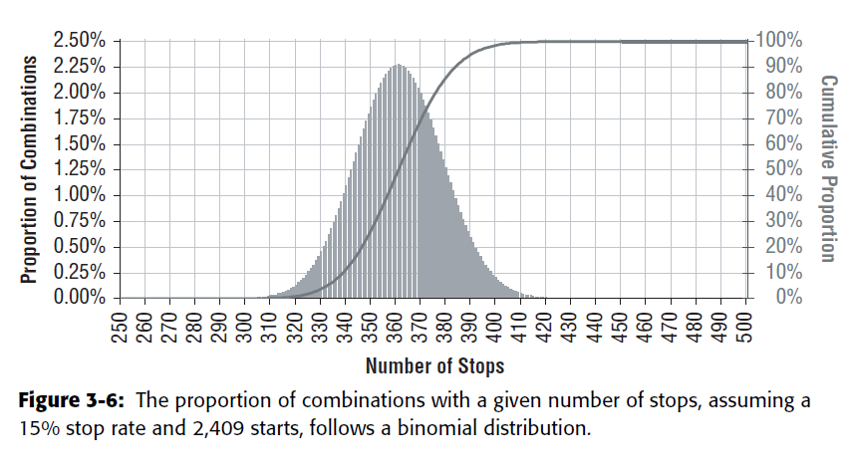
Given the Count, What Is the Probability?
A 15% stop rate should produce, on average, 361 stops (15% of 2,409); this
overall average is called the expected value. The 484 stops are actually 123 more
stops than the expected value, leading to the question: What is the probability (pvalue)
of being 123 or more stops away from the expected value? And this question
has an answer. To a very close approximation, the probability is 0%. The actual
number is more like 0.0000000015%; calculated using the formula 2*MIN(1-
BINOMDIST(484, 2409, 15%, 1), BINOMDIST(484, 2409, 15%, 1)).

Slide 21
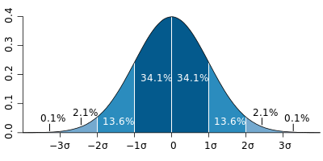

Ratios, and Their Statistics
Standard Error of a Proportion
STDERR = SQRT(<ratio> * (1-<ratio>) / <number of data points>)
The standard error (SE) is the standard deviation of the sampling distribution of a statistic
SELECT stoprate - 1.96 * stderr as conflower, stoprate + 1.96 * stderr as confupper, stoprate, stderr, numstarts, numstops
FROM (
SELECT SQRT(stoprate * (1 - stoprate)/numstarts) as stderr, stoprate, numstarts, numstops
FROM (
SELECT COUNT(*) as numstarts,SUM(CASE WHEN stop_type IS NOT NULL THEN 1 ELSE 0 END) as numstops, AVG(CASE WHEN stop_type IS NOT NULL THEN 1.0 ELSE 0 END) as stoprate
FROM subs
WHERE start_date = '2005-12-28'
) s
) s

Slide 22
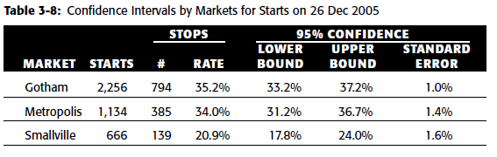
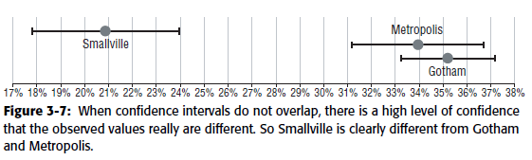
Confidence Interval on Proportions (p130)
SELECT market, stoprate - 1.96 * stderr as conflower,
stoprate + 1.96 * stderr as confupper,
stoprate, stderr, numstarts, numstops
FROM (SELECT market,
SQRT(stoprate * (1 - stoprate)/numstarts) as stderr,
stoprate, numstarts, numstops
FROM (SELECT market, COUNT(*) as numstarts,
SUM(CASE WHEN stop_type IS NOT NULL THEN 1 ELSE 0
END) as numstops,
AVG(CASE WHEN stop_type IS NOT NULL THEN 1.0 ELSE 0
END) as stoprate
FROM subs
WHERE start_date in (‘2005-12-26’)
GROUP BY market) s
) s

